Slide 1
Employee Data Analysis using Excel
STUDENT NAME: T.Nithiya
REGISTER NO: 312214904
DEPARTMENT: Bcom(CA)
COLLEGE: Annai Veilankanni’s college for women

Slide 2
PROJECT TITLE
Employee Performance Analysis using Excel

Slide 3


AGENDA
Problem Statement
Project Overview
End Users
Our Solution and Proposition
Dataset Description
Modelling Approach
Results and Discussion
Conclusion
3/21/2024 Annual Review

Slide 4

PROBLEM STATEMENT
1.A study's own problem statement has three main components: a synthesis or summary of the existing knowledge relevant to the research inquiry, the gaps identified by that review and why those gaps are important, and the kind of research necessary to fill those gaps.
2.A problem statement is a short, clear explanation of an issue or challenge that sums up what you want to change. It helps you, team members, and other stakeholders to focus on the problem, why it's important, and who it impacts. A good problem statement should create awareness and stimulate creative thinking.

Slide 5

PROJECT OVERVIEW
A data analyst is a lot more than a number cruncher. Analysts review data and determine how to solve problems using that data, and learn critical insights about a business's customers and boost profits. Analysts also communicate this information with key stakeholders, including company leadership.
Self-motivated, organized, and efficient data engineer and analyst with relevant technology experience and data processing skills. Data-driven and analytical innovator with excellent problem-solving skills, business acumen, and passion for contributing to large-scale data ingestion and research initiatives.
.

Slide 6

WHO ARE THE END USERS?
Analysts research, analyze and report on different trends. Using either publicly available or collected data, analysts attempt to draw insights that can be used to create actionable strategies in different industries
The term end user typically is the people your products or services are designed for. They are often your customers, defined as people who purchase products from you. In fact, many companies focus on appealing to customers in their marketing campaigns.

Slide 7

OUR SOLUTION AND ITS VALUE PROPOSITION
Data analytics is a powerful tool that can help a company create a compelling value proposition for its customers and prospects. A value proposition is a statement that explains how a product or service solves a problem, provides a benefit, or meets a need for a target market. It also differentiates a company from its competitors and explains why it's the best choice.

Slide 8
Dataset Description
As defined in the first section, a dataset is a collection of data used for analysis and modeling and typically organized in a structured format. That structured format could be an Excel spreadsheet, a CSV file, a JSON file or other formats.
A data set is an ordered collection of data. As we know, a collection of information obtained through observations, measurements, study, or analysis is referred to as data. It could include information such as facts, numbers, figures, names, or even basic descriptions of objects.

Slide 9

THE "WOW" IN OUR SOLUTION
Data analytics can also help companies track which products and services are performing well and predict sales trends—and leverage this qualitative data in …14 Mar 2024
Data analysis provides a deeper understanding of processes, behaviors, and trends. It allows organizations to gain insights into customer preferences, market dynamics, and operational efficiency.
3/21/2024 Annual Review
9

Slide 10
MODELLING
Data analysis provides a deeper understanding of processes, behaviors, and trends. It allows organizations to gain insights into customer preferences, market dynamics, and operational efficiency.
Data modeling of the ETL process streamlines the extract, transform, and loading process by manual efforts. You can improve operational efficiency and productivity by understanding the strategies and optimizing data workflows to automate repetitivreducing unpredictability and e tasks.
10

Slide 11
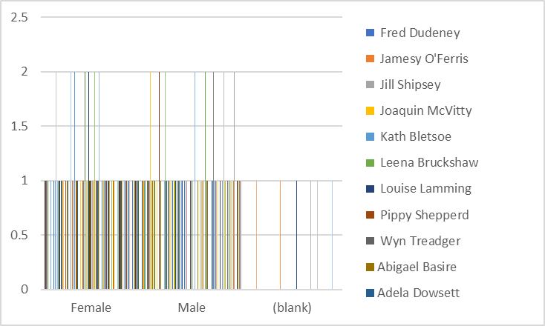
RESULTS
11

Slide 12
conclusion
A data analysis conclusion is a summary of the main points of an analysis, and it provides a direction for further research or action. A good conclusion should: Reprise the questions and conclusions from the introduction Include additional observations or details from the analysis section Raise new questions or suggest future work Reinforce the argument Provide a clear direction for further action or research

